Slide 1
The Army that Never Existed:
The Failure of Social Bots Research
Michael Kreil

Slide 2

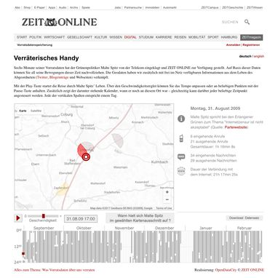
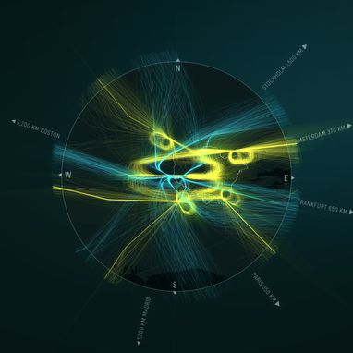
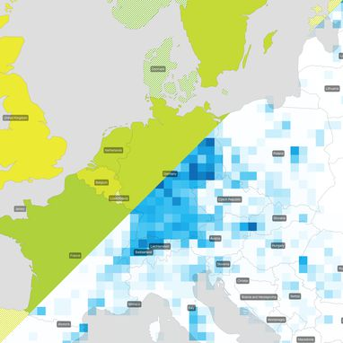
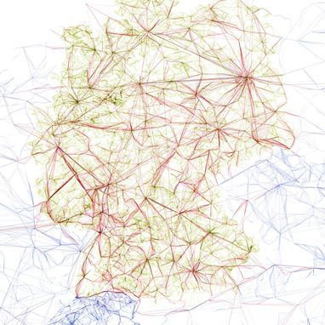
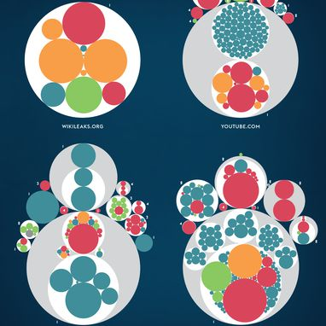
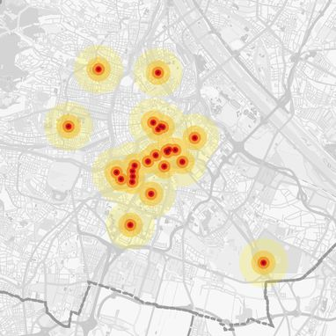
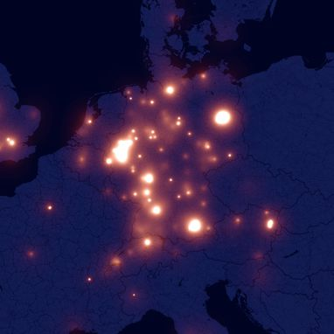
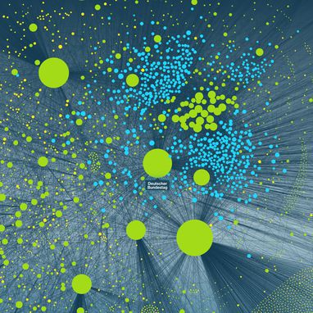
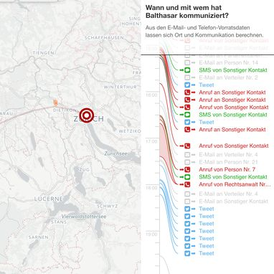
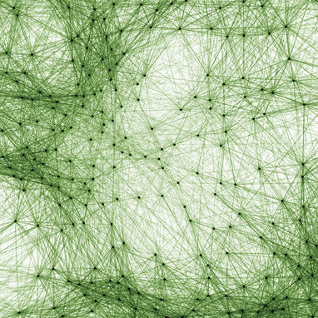
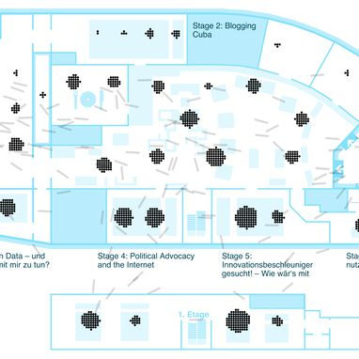
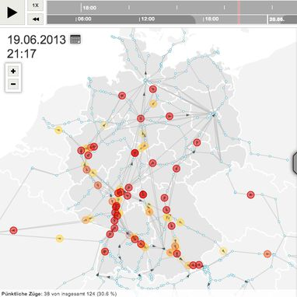
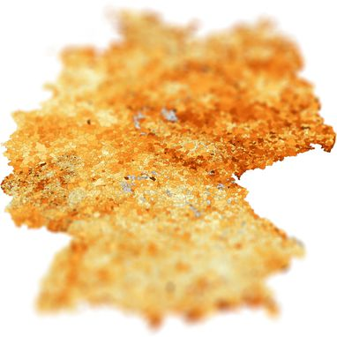
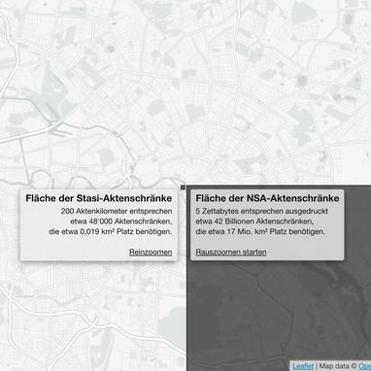

data scientist
data journalist
open data activist
michael-kreil.de

Slide 3

Notes:
social bots: perfect topic
data+papers+social impact

Slide 4
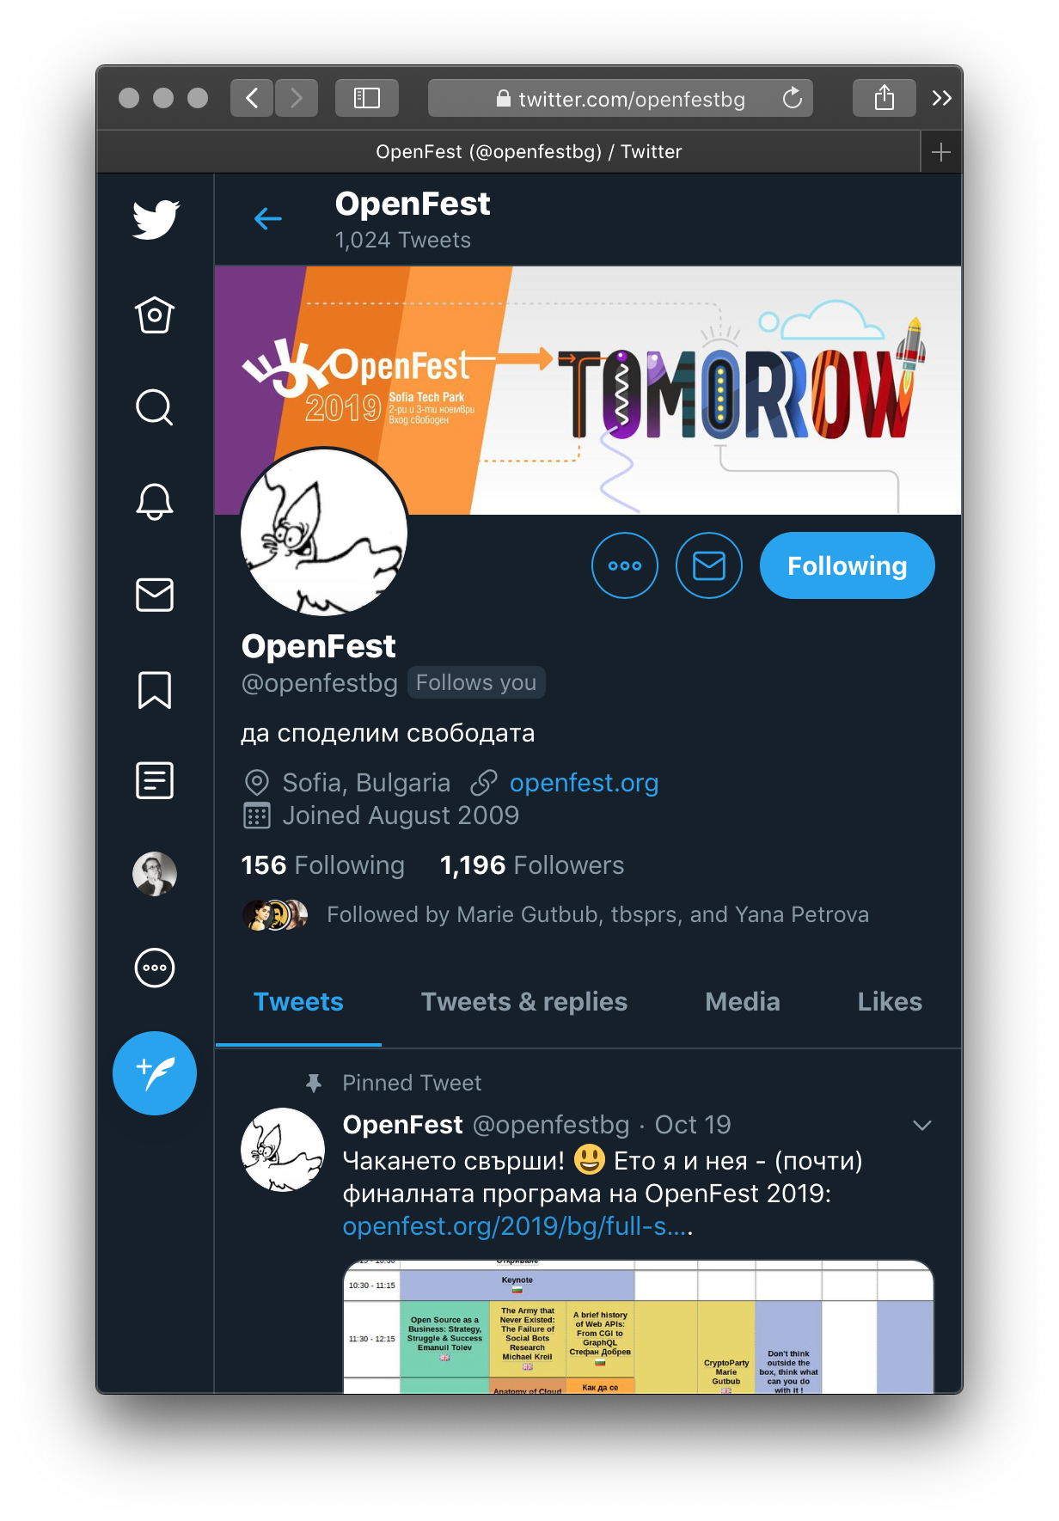
Notes:
How API works

Slide 5
twitter.com/get_tweet?id=1184477532474753024

Slide 6
twitter.com/get_tweet?id=1184477532474753024
created_at:"Wed Oct 16 14:33:44 +0000 2019",
id_str:"1184477532474753024",
full_text:"@MichaelKreil will present \"The Army that Never Existed: …“,
retweet_count:13,
favorite_count:13,
is_quote_status:true,
quoted_status_id_str:"1184475221866287104",
user_id_str:"50503396",
conversation_id_str:“1184477532474753024“,
…

Slide 7
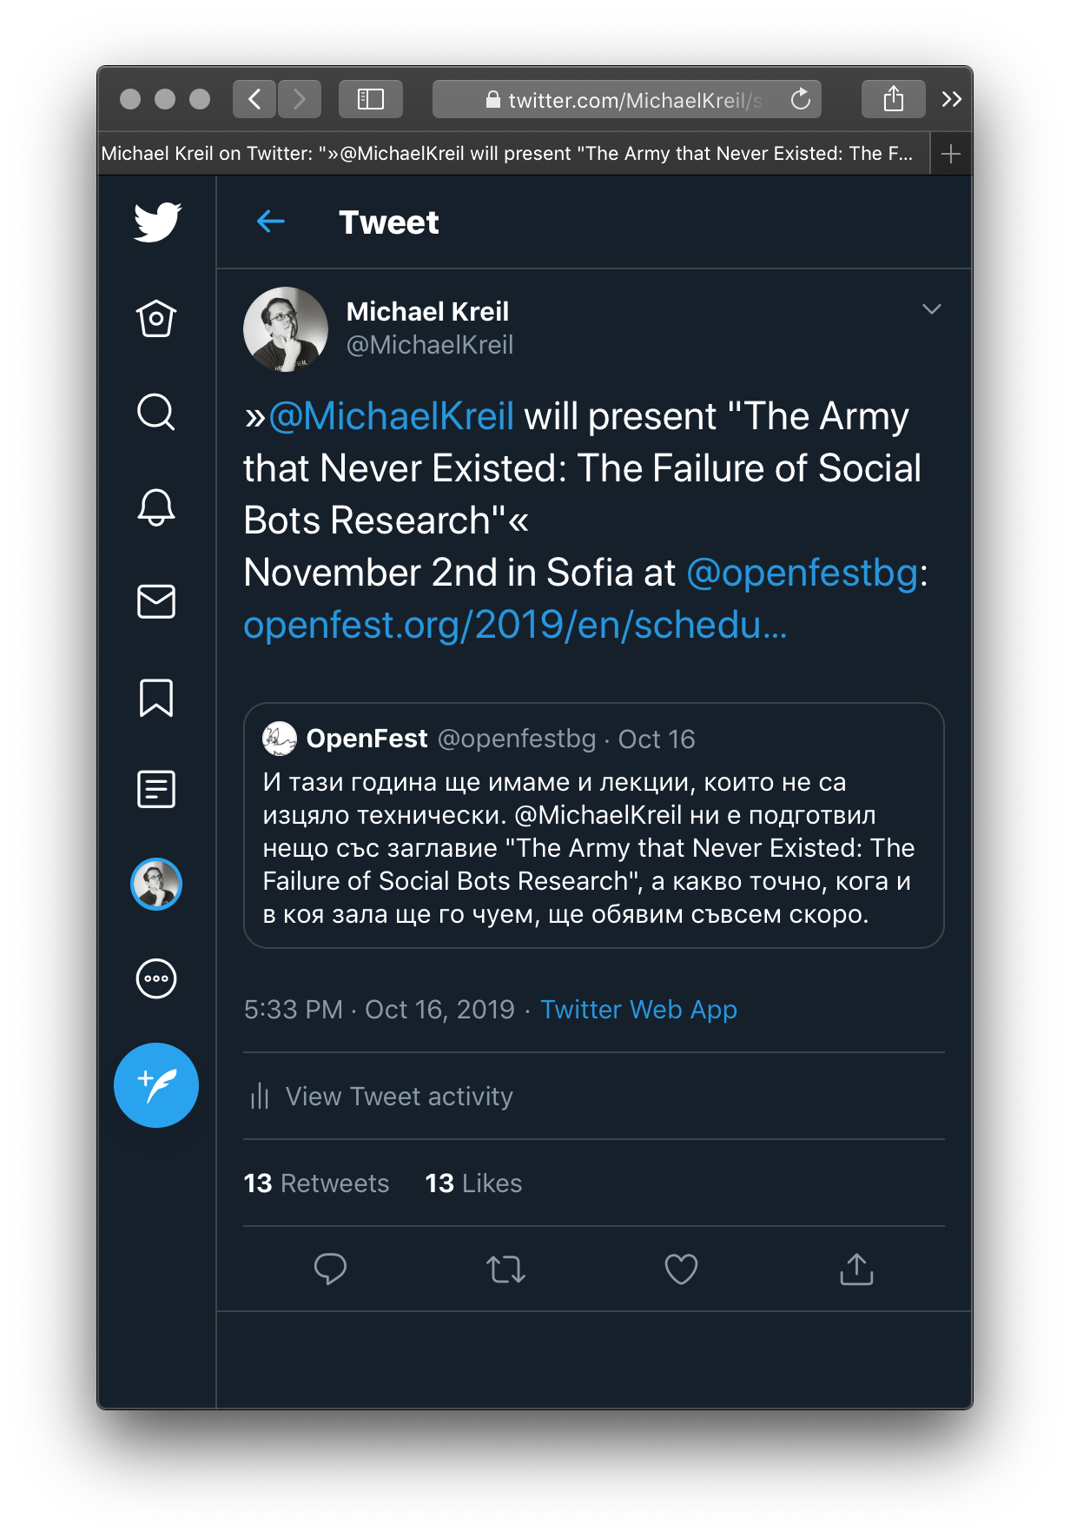
twitter.com/get_tweet?id=1184477532474753024
created_at:"Wed Oct 16 14:33:44 +0000 2019",
id_str:"1184477532474753024",
full_text:"@MichaelKreil will present \"The Army that Never Existed: …“,
retweet_count:13,
favorite_count:13,
is_quote_status:true,
quoted_status_id_str:"1184475221866287104",
user_id_str:"50503396",
conversation_id_str:“1184477532474753024“,
…

Slide 8
twitter.com
iPhone
iPad
Android
HootSuite
Tweetdeck
Echofon
Tweetbot
Facebook
Instagram
Tumblr
IFTTT
…

Slide 11
Notes:
700-800 speed of the API

Slide 12
1.6 million german speaking Twitter accounts
Austria
Switzerland

Slide 13
„my kung fu is strong“

Slide 14
„my kung fu is strong“
Let’s find social bots!

Slide 16
ABS-CBN
BBC
Buzzfeed
CBC
CNET
Engadget
Financial Times
IEEE SPECTRUM
Independent
NPR
NewScientist
The Atlantic
The Telegraph
The New York Times
The Washington Post
Forbes
MOTHERBOARD
PHYS.ORG
WIRED
CNBC
Fast Company
MIT Technology Review
Pew Research Center
The Conversation
The Sun
US News
The Guardian
Bloomberg
Businessinsider
Mashable
TechCrunch
The Hill
The Sydney Morning Herald
The Times

Slide 17
ABS-CBN
BBC
Buzzfeed
CBC
CNET
Engadget
Financial Times
IEEE SPECTRUM
Independent
NPR
NewScientist
The Atlantic
The Telegraph
The New York Times
The Washington Post
Forbes
MOTHERBOARD
PHYS.ORG
WIRED
CNBC
Fast Company
MIT Technology Review
Pew Research Center
The Conversation
The Sun
US News
The Guardian
Bloomberg
Businessinsider
Mashable
TechCrunch
The Hill
The Sydney Morning Herald
The Times

Slide 18
ABS-CBN
BBC
Buzzfeed
CBC
CNET
Oxford
Engadget
Financial Times
27 times
IEEE SPECTRUM
"The Computational
Independent
Propaganda Project
NPR
of Oxford University"
NewScientist
The Atlantic
The Telegraph
The New York Times
The Washington Post
Forbes
MOTHERBOARD
PHYS.ORG
WIRED
CNBC
Fast Company
MIT Technology Review
Pew Research Center
The Conversation
The Sun
US News
The Guardian
Bloomberg
Businessinsider
Mashable
TechCrunch
The Hill
The Sydney Morning Herald
The Times

Slide 19
ABS-CBN
BBC
Buzzfeed
CBC
CNET
Oxford
Engadget
Financial Times
27 times
IEEE SPECTRUM
"The Computational
Independent
Propaganda Project
NPR
of Oxford University"
NewScientist
The Atlantic
The Telegraph
The New York Times
The Washington Post
Forbes
MOTHERBOARD
PHYS.ORG
Southern
WIRED
California
CNBC
Fast Company
/Indiana
MIT Technology Review
15 times
Pew Research Center
The Conversation
The Sun
US News
The Guardian
Bloomberg
Businessinsider
Mashable
TechCrunch
The Hill
The Sydney Morning Herald
The Times

Slide 20
ABS-CBN
BBC
Buzzfeed
CBC
CNET
Oxford
Engadget
Financial Times
27 times
IEEE SPECTRUM
"The Computational
Independent
Propaganda Project
NPR
of Oxford University"
NewScientist
The Atlantic
The Telegraph
The New York Times
The Washington Post
Forbes
MOTHERBOARD
PHYS.ORG
Southern
WIRED
California
CNBC
Fast Company
/Indiana
MIT Technology Review
15 times
Pew Research Center
The Conversation
The Sun
US News
The Guardian
Bloomberg
Berkeley
Businessinsider
/Swansea
Mashable
TechCrunch
9 times
The Hill
The Sydney Morning Herald
The Times

Slide 21
Comprop/Oxford
Bots, #StrongerIn, and #Brexit: Computational Propaganda during the UK-EU Referendum
Bots and Automation over Twitter during the First U.S. Presidential Debate
Bots and Automation over Twitter during the Second U.S. Presidential Debate
Bots and Automation over Twitter during the Third U.S. Presidential Debate
Bots and Automation over Twitter during the U.S. Election

Slide 22
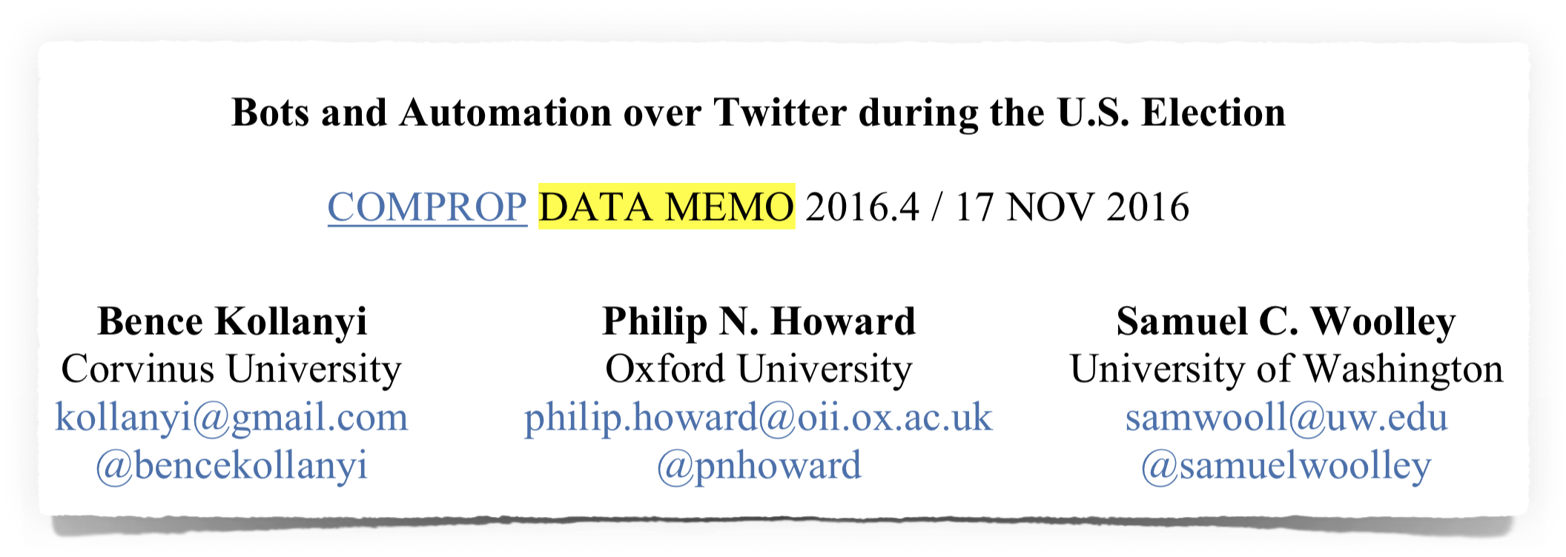
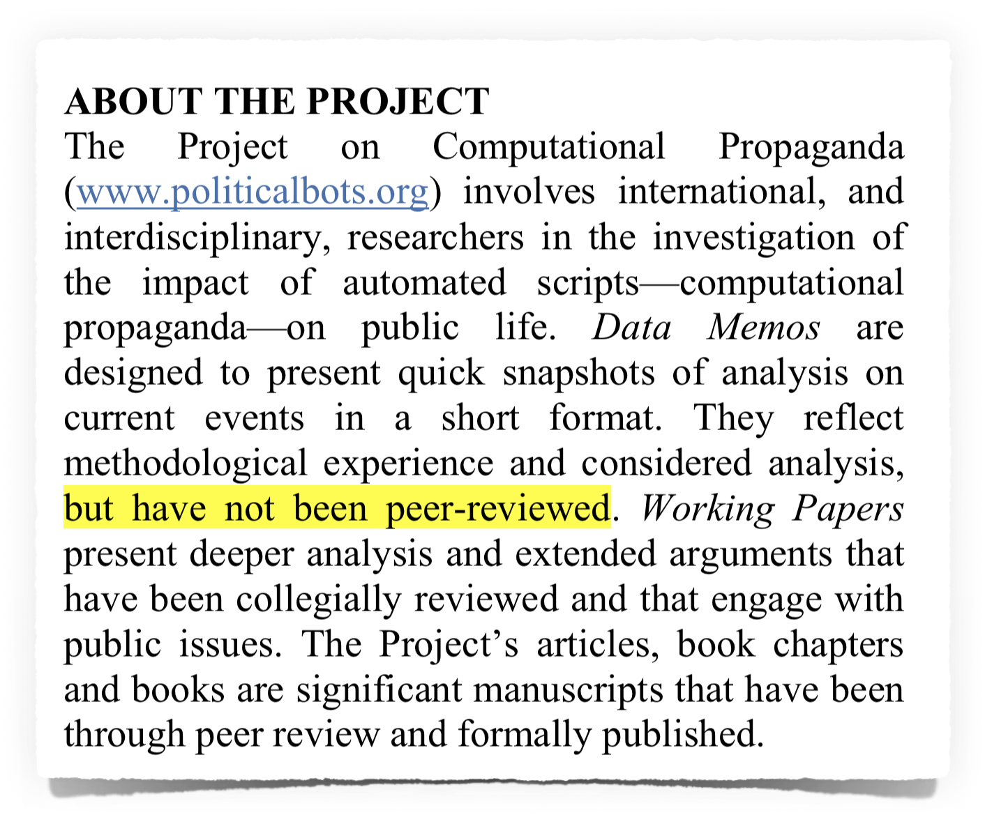
Notes:
They failed the peer review
never printed in a scientific journal
but huge coverage in media

Slide 23
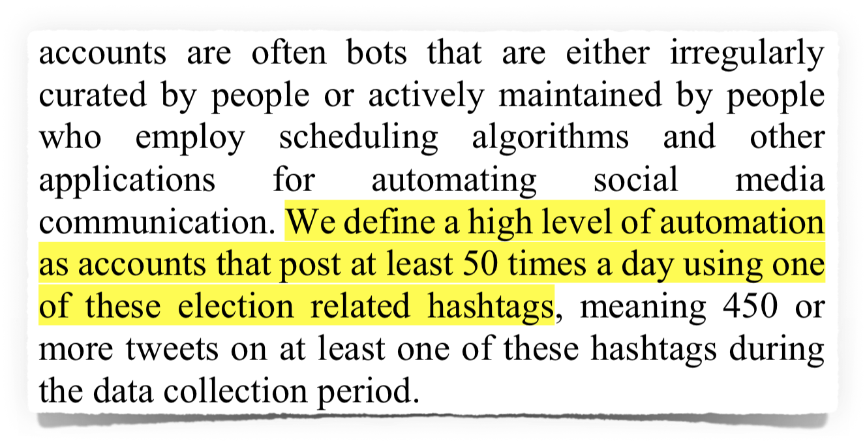
What the paper claims:
T
#
T
T
T
#
T
T
T
T
#
#
T
What actually reproduces the results:
T
#
T
T
T
#
T
T
T
T
#
#
T

Slide 24
So basically:
"We define Social Bots as accounts
that tweet more than 50 times a day…“

Slide 25
So basically:
"We define Social Bots as accounts
that tweet more than 50 times a day…“
famous accounts with
more than 50 tweets/day:
nytimes (108.3)
CNN (156.6)
NBA (115)
NFL (81.1)
TheEconomist (92.2)
Reuters (318.4)
WSJ (93.3)
TIME (78.9)
Forbes (81.6)
Starbucks (151.7)
McDonalds (127.1)
AskPlayStation (275.6)
British Airways (280.8)
journalist Glenn Greenwald (50.2)
author Cory Doctorow (142.2)

Slide 26

social bot tweets
during US election:
17.9%
social bot tweets
by verified accounts:
30.9%

Slide 27
Questions to Comprop/Oxford:
Does using a pro Trump hashtag mean, someone is pro Trump?
Spam accounts are usually using trending hashtags.
50 tweets per day is heavy automation?
Why 50 and not 30 or 100?
Do you have any proof, that you found Social Bots.
Did this had any influence?
Why is ComProp not sharing the data and source code?
Why do they make it hard to verify their results?

Slide 28
Summary:
Comprop/Oxford detected active users, like supporters, journalists and spammers

Slide 29
ABS-CBN
BBC
Buzzfeed
„Bots and Automation over Twitter during the U.S. Election“ did not reach the scientific quality to be published in any scientific journal!
But it was good enough to be covered by major media outlets!
Maybe because the theory is more exciting than reality?
CBC
CNET
Oxford
Engadget
Financial Times
27 times
IEEE SPECTRUM
"The Computational
Independent
Propaganda Project
NPR
of Oxford University"
NewScientist
The Atlantic
The Telegraph
The New York Times
The Washington Post
Forbes
MOTHERBOARD
PHYS.ORG
Southern
WIRED
California
CNBC
Fast Company
/Indiana
MIT Technology Review
15 times
Pew Research Center
The Conversation
The Sun
US News
The Guardian
Bloomberg
Berkeley
Businessinsider
/Swansea
Mashable
TechCrunch
9 times
The Hill
The Sydney Morning Herald
The Times

Slide 30
Southern California/Indiana

Slide 31
Botometer
aka BotOrNot
Social Bots
Humans
metadata
metadata
"Machine Learning"
high accuracy
to distinguish between
bots and humans

Slide 32

Botometer
aka BotOrNot
Spam accounts
Social Bots
Humans
metadata
metadata
"Machine Learning"
high accuracy
to distinguish between
bots and humans

Slide 33
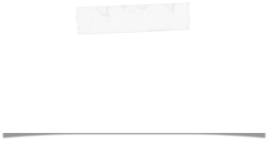
Botometer
aka BotOrNot
Spam accounts
Social Bots
Humans
metadata
metadata
"Machine Learning"
Never verified
"in the wild"
high accuracy
to distinguish between
bots and humans

Slide 34
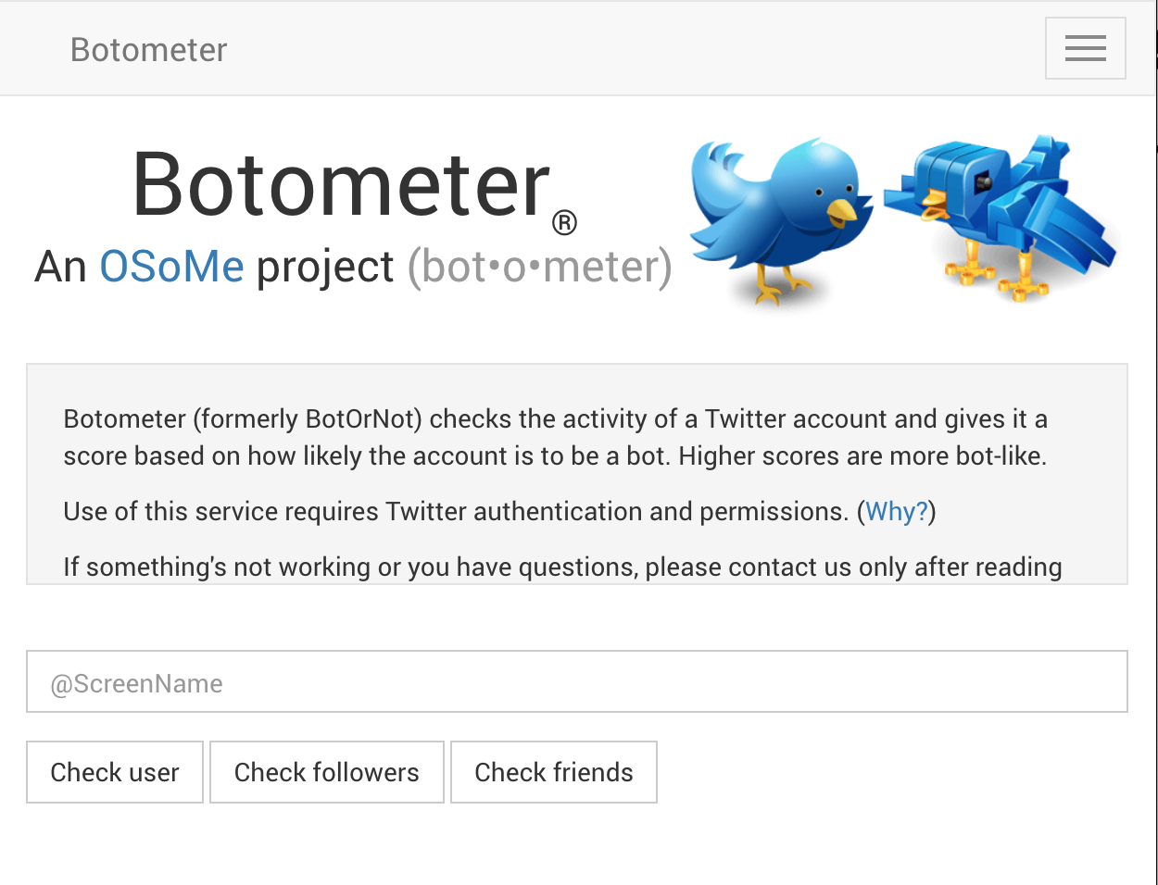
https://botometer.iuni.iu.edu/

Slide 35
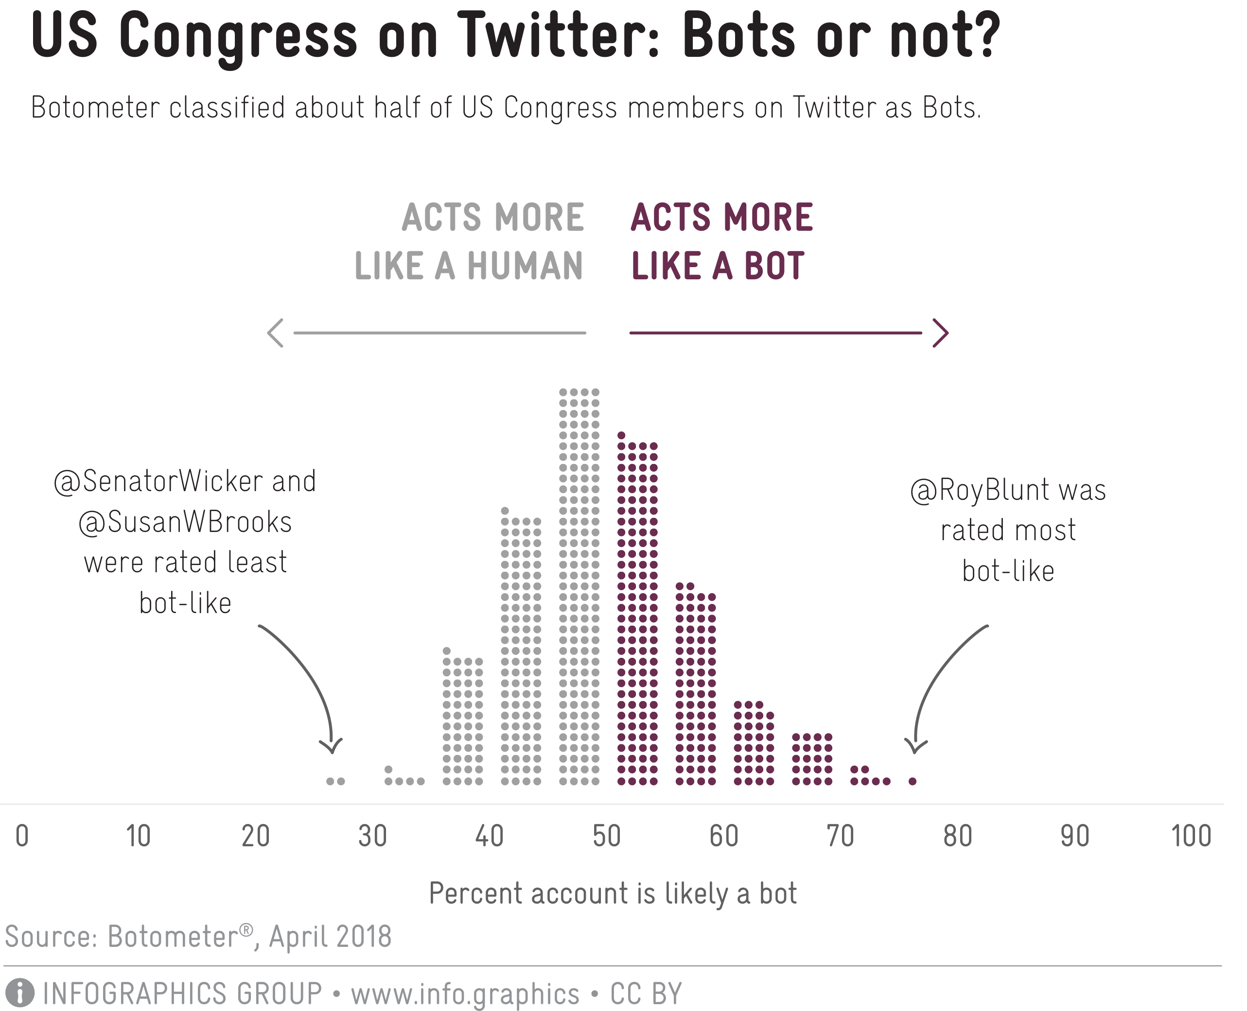

Slide 36
According to Botometer …
65 nobel prize laureates:
12% are bots

Slide 37
According to Botometer …
3137 female directors:
14% are bots

Slide 38
According to Botometer …
96 NASA accounts:
14% are bots

Slide 39
According to Botometer …
17.7% of @Reuters journalists are bots
21.9% of @UN_Women staff are bots
35.9% of the staff of german news agency @dpa are bots
30.5% of the federal parliament of Bavaria are bots

Slide 40
According to Botometer …
Notes:
Members of the parliament

Slide 41
According to Botometer …
937 bots from botwiki.org:
61% are humans

Slide 42
Botometer reaches
false-positive/-negative rates
up to 50% and more!
(worse than flipping a coin)

Slide 43
Botometer
is used by
many other scientists

Slide 44
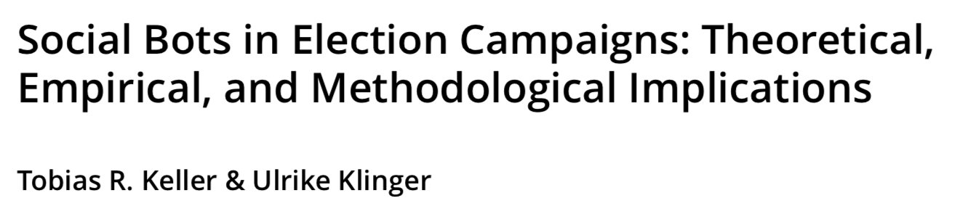
Twitter followers
of german parties:
10% are bots
Notes:
Botometer had an update, changed algorithm or parameters
different results

Slide 45
of 530'000 followers
of german parties:
53% are bots
Notes:
UMAP, interactive tool, open source

Slide 46
Notes:
only one tweet

Slide 47
Notes:
inactive for years

Slide 48
Notes:
accounts that are active and interact with other accounts

Slide 49
Notes:
active, automated accounts:
hashtag spam, url spam, porn spam ... not a single political bot

Slide 50
Botometer is a blackbox algorithm
that classifies people as bots
and delegitimises movements.
Notes:
social impact, closed source

Slide 51
ABS-CBN
BBC
Buzzfeed
CBC
CNET
Oxford
Engadget
Financial Times
27 times
IEEE SPECTRUM
"The Computational
Independent
Propaganda Project
NPR
of Oxford University"
NewScientist
The Atlantic
The Telegraph
The New York Times
The Washington Post
Forbes
MOTHERBOARD
PHYS.ORG
Southern
WIRED
California
CNBC
Fast Company
/Indiana
MIT Technology Review
15 times
Pew Research Center
The Conversation
The Sun
US News
The Guardian
Bloomberg
Berkeley
Businessinsider
/Swansea
Mashable
TechCrunch
9 times
The Hill
The Sydney Morning Herald
The Times

Slide 52
Berkeley/Swansea

Slide 53
https://blog.plan99.net/did-russian-bots-impact-brexit-ad66f08c014a
Mike Hearn:
"I am one of the very, very few people in the world who has actually fought bots on social media platforms. As a member of the Google abuse team from 2010–2013 I spent a large amount of time working on anti-spam and anti-automation platforms."
"It is the most irresponsible abuse of maths
I’ve seen for a long time."

Slide 54
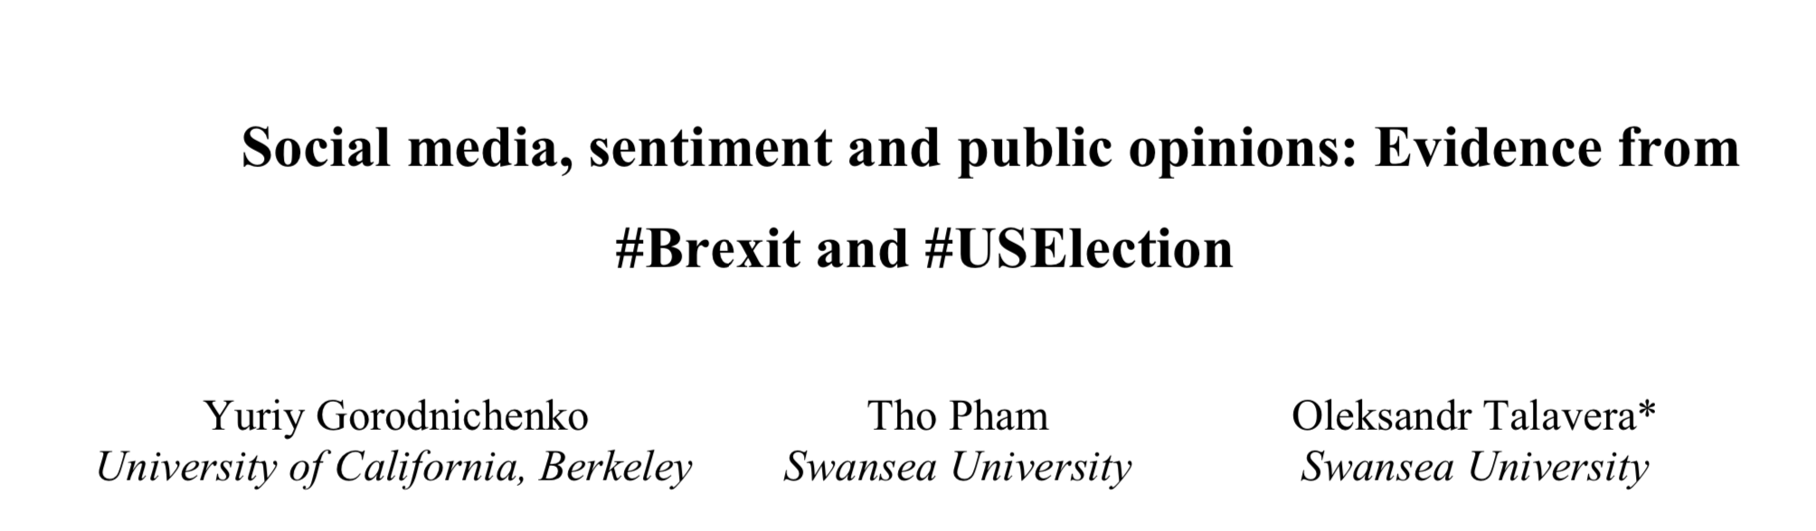
more votes for Trump
Social Bot tweets for Trump
more tweets for Trump

Slide 55
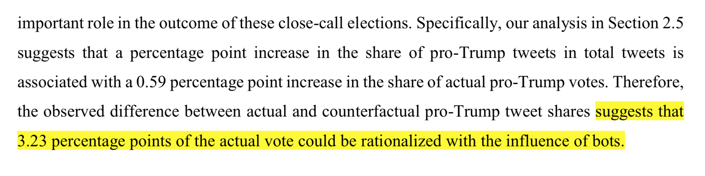
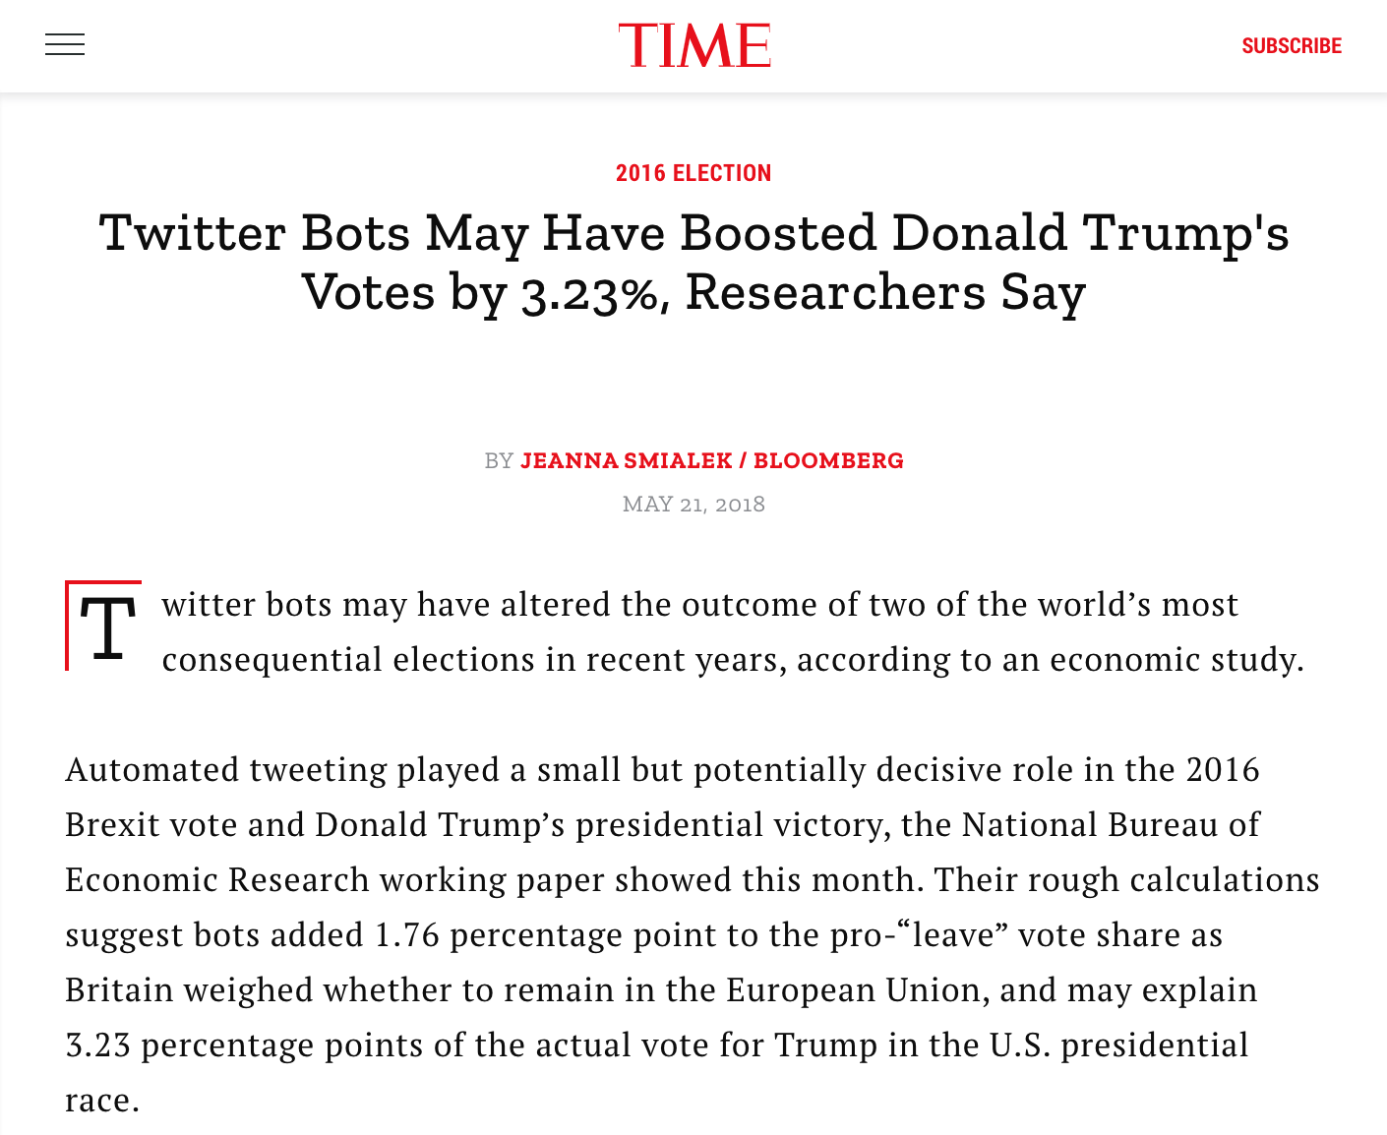
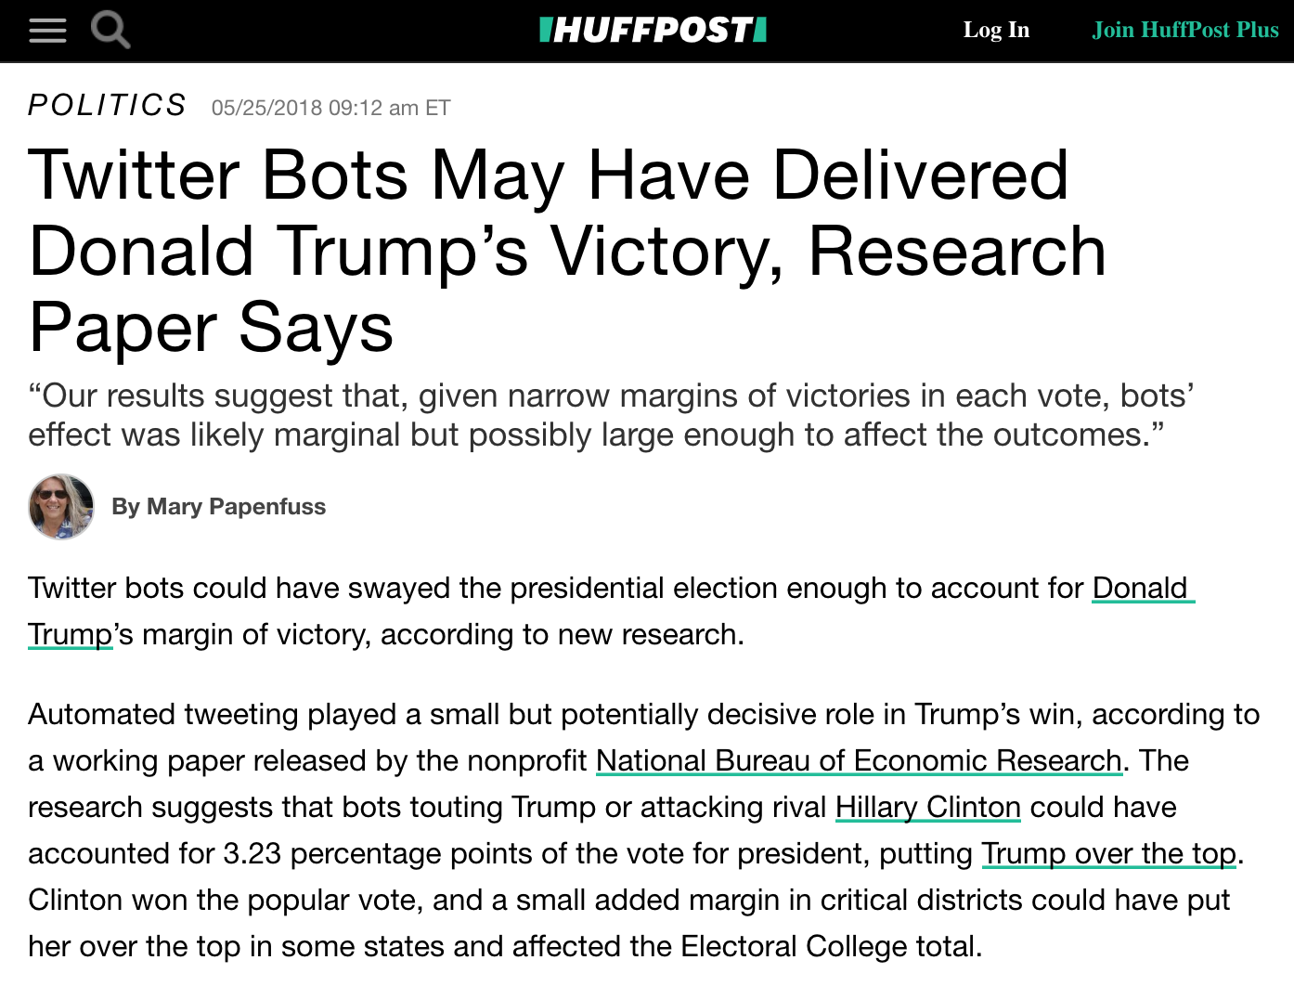

Slide 56
ABS-CBN
BBC
Buzzfeed
CBC
CNET
Oxford
Engadget
Financial Times
27 times
IEEE SPECTRUM
"The Computational
Independent
Propaganda Project
NPR
of Oxford University"
NewScientist
The Atlantic
The Telegraph
The New York Times
The Washington Post
Forbes
MOTHERBOARD
PHYS.ORG
Southern
WIRED
California
CNBC
Fast Company
/Indiana
MIT Technology Review
15 times
Pew Research Center
The Conversation
The Sun
US News
The Guardian
Bloomberg
Berkeley
Businessinsider
/Swansea
Mashable
TechCrunch
9 times
The Hill
The Sydney Morning Herald
The Times

Slide 57
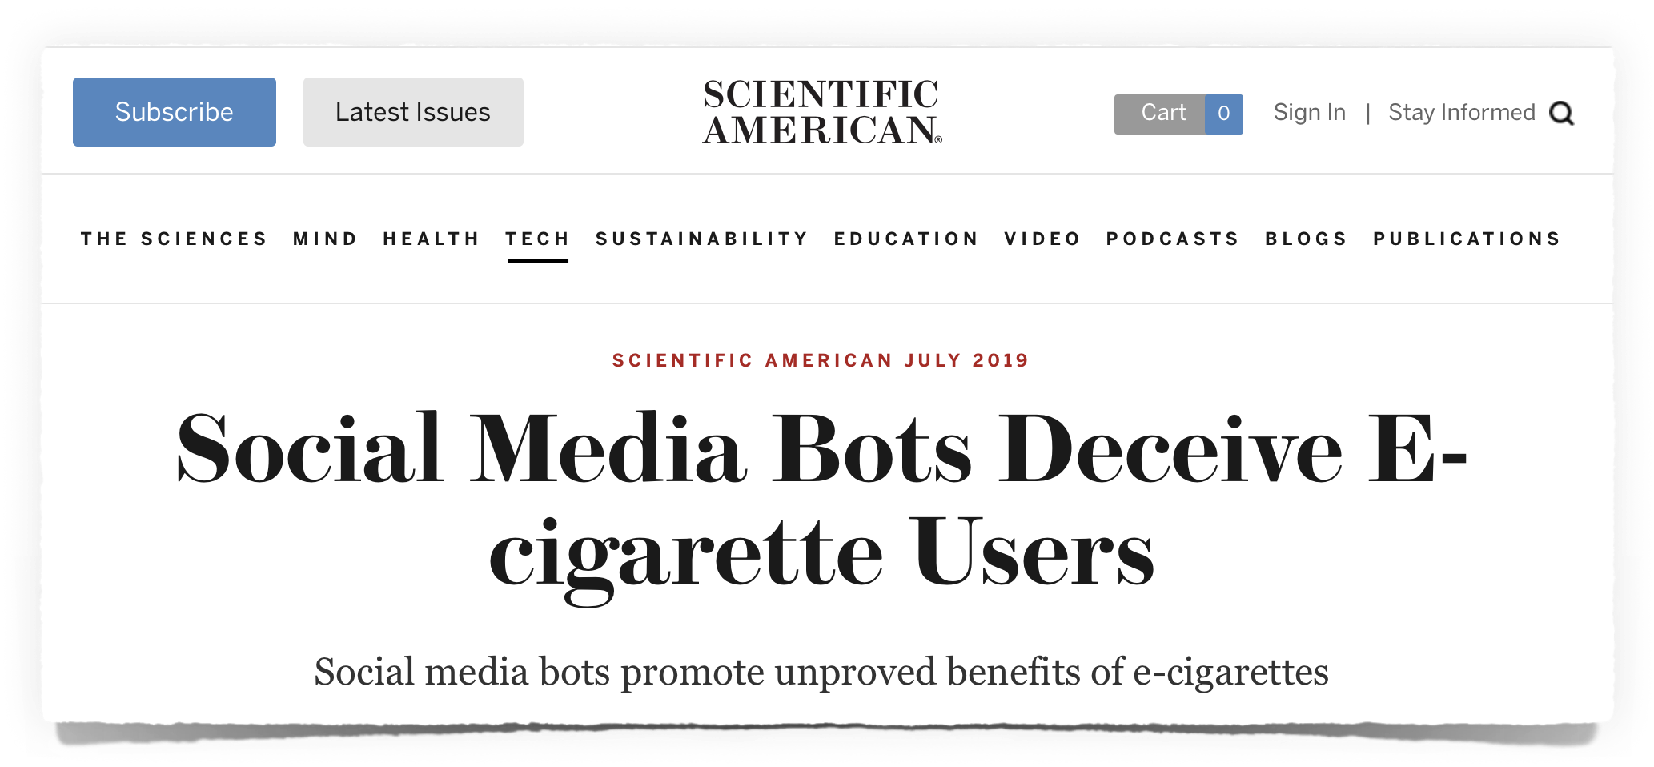
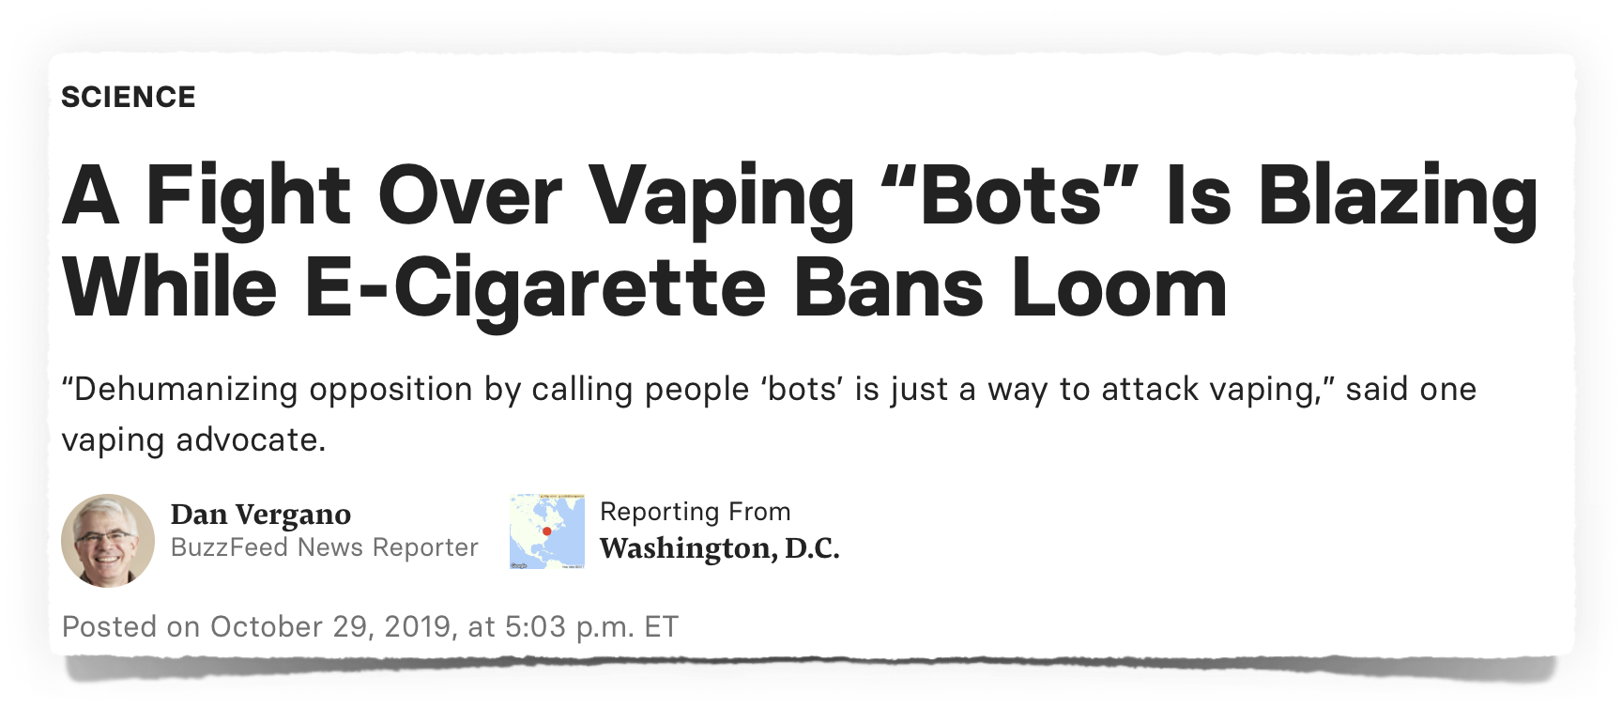


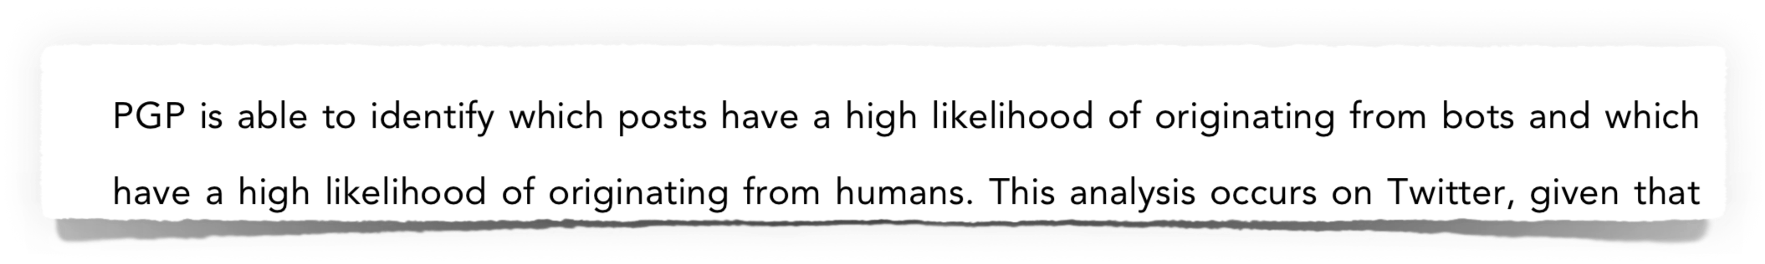
No explanation of the method!
No source code!
No data!
Only bold and unproven allegations!

Slide 58
Social Bot research
is a total disaster!
Notes:
They are

Slide 59
The whole theory of
"Social Bots influenced elections"
can be fully explained
by the failure of these research groups.

Slide 60
Research groups of
Oxford, South California/Indiana, Berkeley/Swansea
invented methods,
that are unscientific,
have never been proven,
have terrible false-positive rates
and are easy to falsify.

Slide 61
All their papers have to be reviewed again
and have to be revoked if necessary.
This includes all other research
from all other groups,
using their methods.

Slide 62
How we got in to that mess?
Many media outlets where shocked
by Brexit and the election of Donald Trump.
They were desperately looking for an explanation.
Unknown scientist gave them one.

Slide 63
How we got in to that mess?
Some scientist are in the center of media attention.
This is good for their ego and their funding.
But this is bad for the unbiasedness of science.

Slide 64
How we fix that mess?
We need the scientific community
to conduct an unbiased review
of these social bot papers!

Slide 65

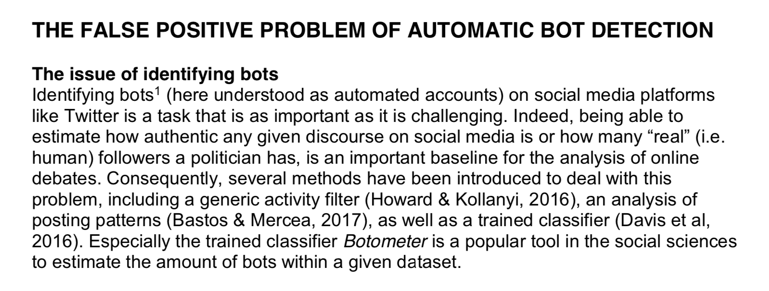
Notes:
Adrian Rauchfleisch and Jonas Kaiser

Slide 66
How we fix that mess?
I demand that the research groups of
Oxford, South California/Indiana, Berkeley/Swansea
publish their source code in all versions
and share their data with third parties.

Slide 67
Why is it urgent?
Dangerous and stupid laws are being prepared.

Slide 68
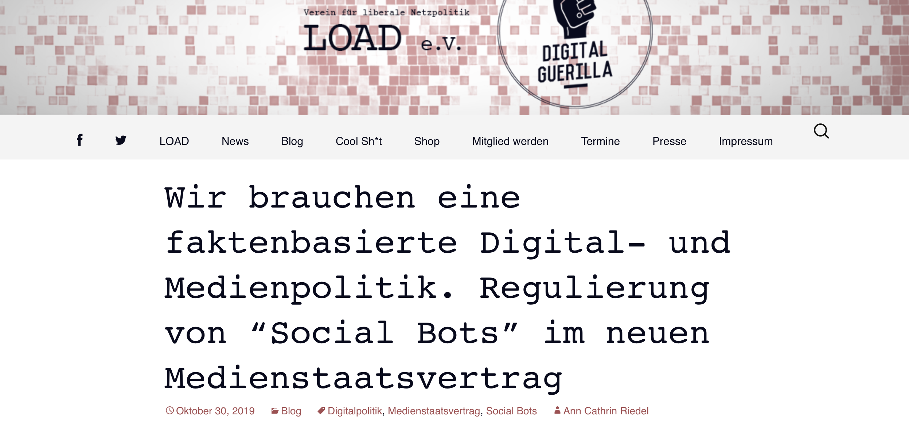
"We need a fact-based digital and media policy.
Regulation of "social bots" in the new State Media Treaty."
https://www.load-ev.de/2019/10/30/wir-brauchen
Notes:
labelling automated tweets

Slide 69
Dear scientist: Please learn from
Open Source and Open Data
communities.
Notes:
Especially research and algorithms with impact

Slide 70
Thanks
Twitter: @MichaelKreil
email: contact@michael-kreil.de
slides, notes, papers, sources, codes, tools, data, graphics:
https://github.com/MichaelKreil/openbots/wiki
Notes:
research about the methods
legislative initiatives

